Slide 1

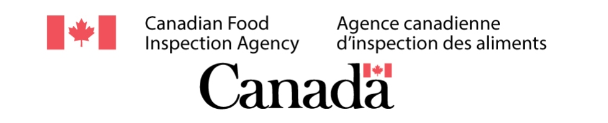
Food Scraps
CANDEV Data Challenge

Slide 2

Problem Summary
The Canadian Food Inspection Agency (CFIA) would like to know more about food producing companies
The goal is to inspect the most outstanding companies that breach most rules, and not waste time inspecting other reputable companies

Slide 3

Our Solution
Randomly selected food companies from Canada to inspect.
Used web-scraping to see if there is a correlation between the company, and food inspection keywords such as (food contamination, bacteria, food poisoning… etc ).
Automated the process of finding employee ratings, company size, and revenue of each company

Slide 4
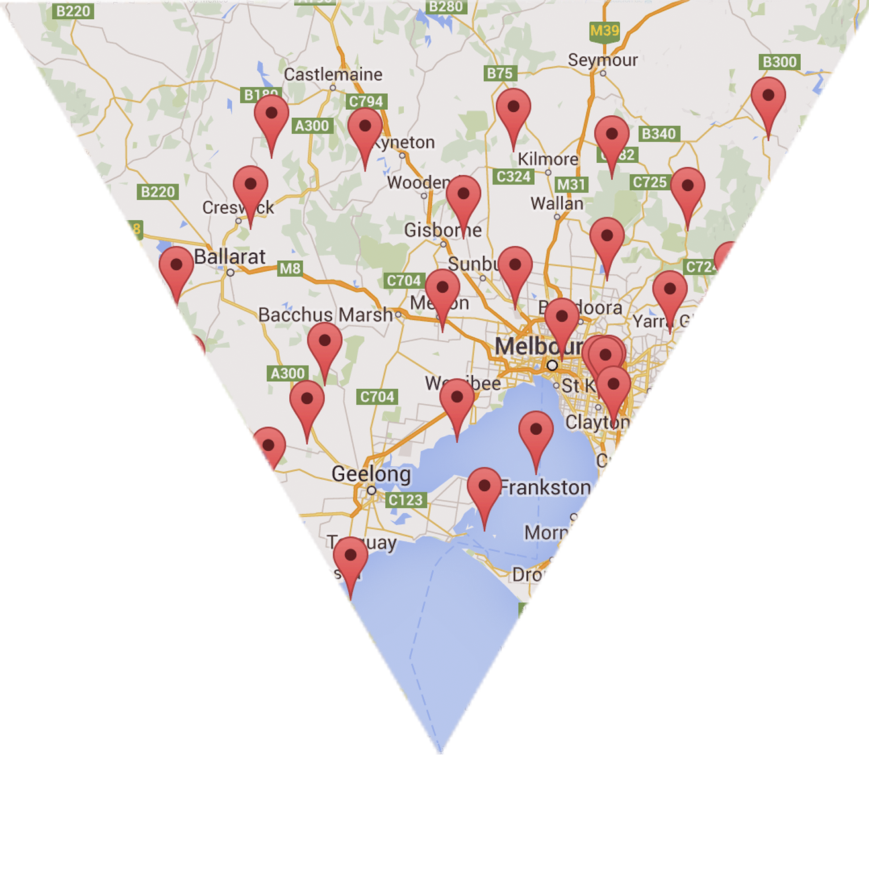

Created a formula that would use all gathered data to give an overall score
Pinned all selected companies on an interactive map that shows the breakdown of the score of each company (HTML. CSS, Javascript, Google Maps API)
If the internal data of each company was given, we could have used artificial intelligence to test our program

Slide 5

Demonstration

Slide 6
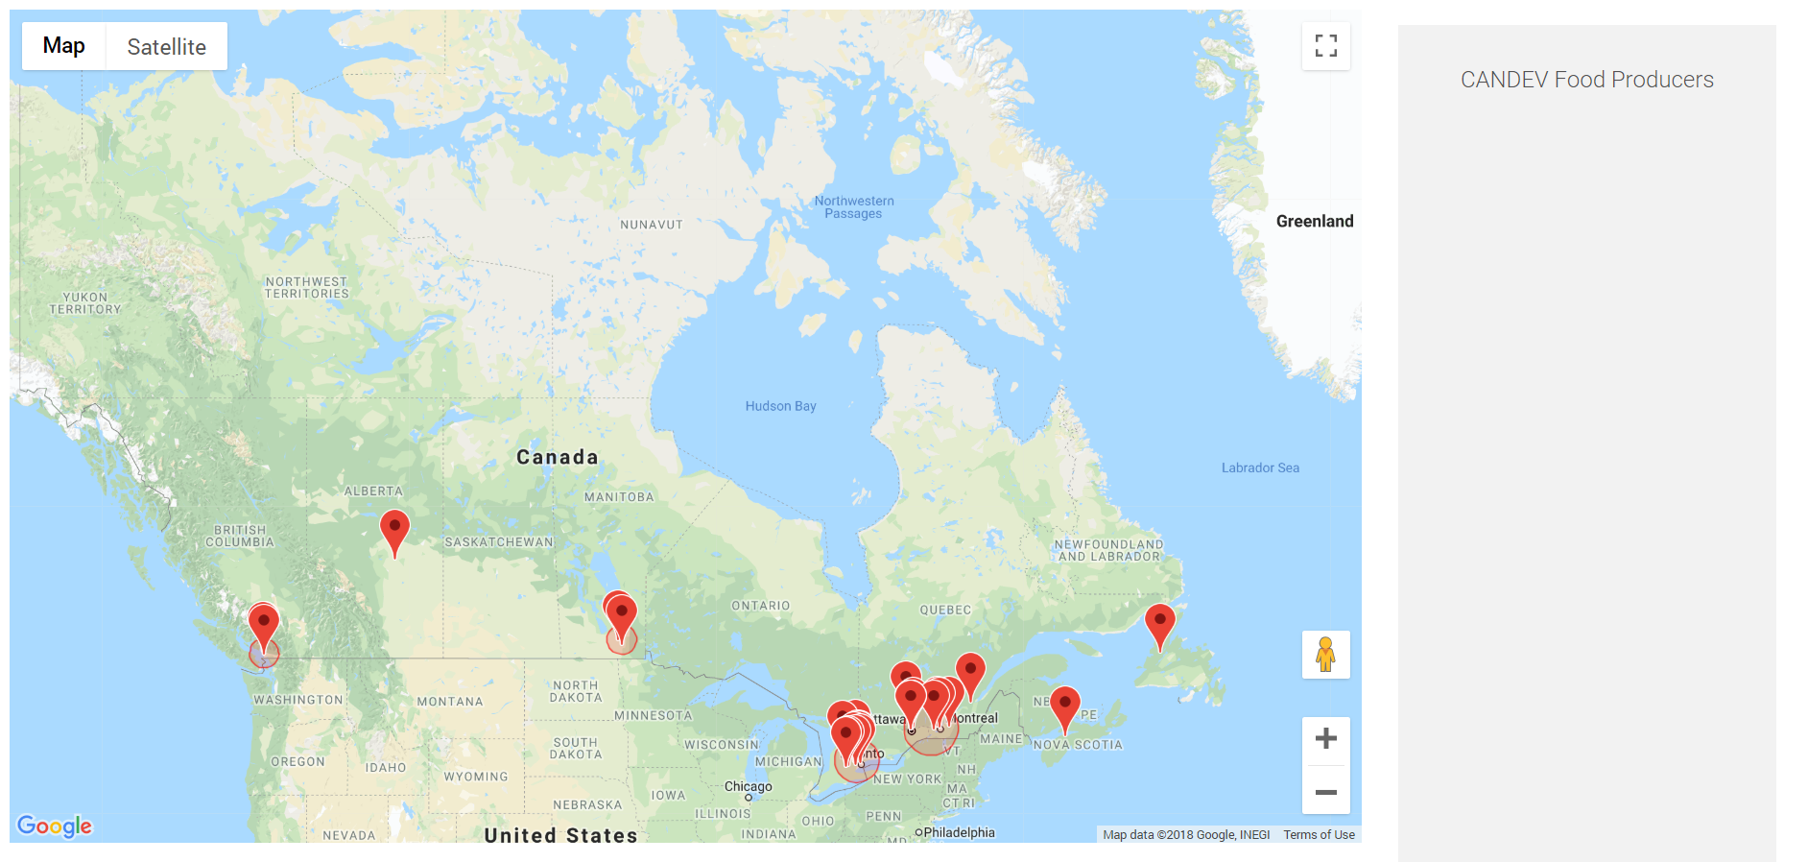
Each company that has a low score is represented as a pin
Red Zones highlight a dense area of companies that have a low score

Slide 7
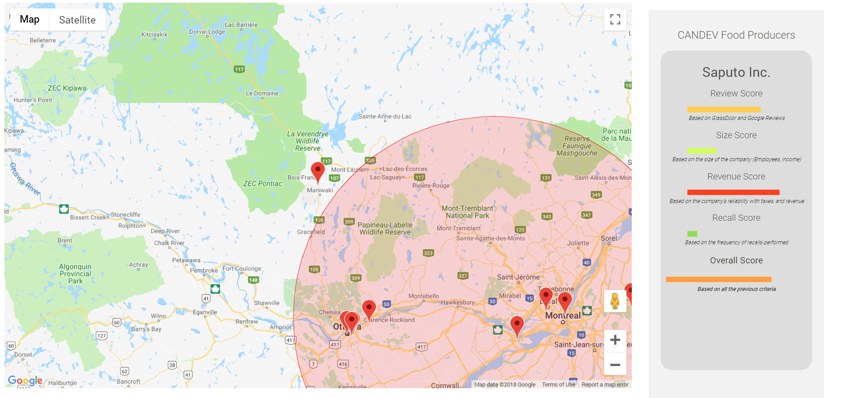
Clicking on a pin shows the breakdown of its score
The selected pin begins to animate
The last score is the overall score of the selected company

